Slide 1
Divisional Overview
University Relations and Marketing
Vice President Donna Gibbs

Slide 2
University Relations & Marketing
Click mouse to proceed through presentation
University Relations & Marketing leads strategic marketing, communications and community relations activities that enhance awareness, strengthen our brand, and increase engagement with our many diverse audiences.
WESTERN WASHINGTON UNIVERSITY | MAKE WAVES.

Slide 3
University Relations & Marketing
Click mouse to proceed through presentation
Strategic Goals and Objectives:
Build and sustain stakeholder partnerships and investment
Cultivate relationships within and between the campus and our communities
Foster public and government support for Western
Foster a more inclusive culture
Illustrate how Western serves the public good
Increase campus and public understanding of the Western brand
Promote learning and research opportunities for students, faculty, and staff
Proactively and effectively tell Western’s story
Promote and improve economic vitality in local communities and beyond
WESTERN WASHINGTON UNIVERSITY | MAKE WAVES.

Slide 4
University Relations & Marketing
Click mouse to proceed through presentation
The Division is led by Vice President Donna Gibbs and includes the following departments:
University Communications
University Marketing & Brand Strategy
Visual Media Production
Community Relations
Small Business Development Center
Tribal Relations
Washington Coalition for the Public Good
Web Communication Technologies
WESTERN WASHINGTON UNIVERSITY | MAKE WAVES.

Slide 5
University Communications
Click mouse to proceed through presentation
Media Relations
UCOMM distributes news releases to local, statewide, and national media. Per a long-established university practice, all news releases must be distributed via this office. The only exceptions are Athletics, and the Associated Students Publicity Center, which distribute news releases for their specific areas.
Emergency Communications
UCOMM is actively involved in planning for and responding to emergency communication needs. This office operates the RAVE emergency communications system, which includes capabilities for rapidly sending out mass mobile text messages, emails, social media messages, university homepage messages, desktop messages, digital signage and audio alerts.
WESTERN WASHINGTON UNIVERSITY | MAKE WAVES.

Slide 6
University Communications (continued)
Click mouse to proceed through presentation
Online and Print Publications
UCOMM is the major content provider for online, print and other information, including:
Western Today, an online campus newsletter distributed Monday through Friday with a daily listing of news and announcements important to the campus community.
Window Magazine, features stories showcasing the best of Western students, faculty, staff and alumni. It is distributed three times per school year to approximately 135,000 WWU alumni and friends of the university.
WWU Family Connection, a monthly e-newsletter to all families throughout the year, produced by UComm and New Student Services/Family Outreach.
Online campus-wide events calendar.
WESTERN WASHINGTON UNIVERSITY | MAKE WAVES.

Slide 7
University Communications (continued)
Click mouse to proceed through presentation
Web Sites/Social Media
UCOMM is responsible for editorial content and oversight on the WWU institutional homepage and for coordination of the use of social media by campus programs and departments across a range of platforms including Facebook, Instagram, Twitter and YouTube.
WESTERN WASHINGTON UNIVERSITY | MAKE WAVES.

Slide 8
University Marketing & Brand Strategy
Click mouse to proceed through presentation
Branding and Marketing
The University Marketing team is responsible for ensuring the integrity of the Western brand and that its use is both consistent and integrated across the University. The Marketing team manages the University-wide brand design system and Design Conductor tools for designers across campus.
Recruitment and Brand Advertising
University Marketing oversees strategy, creative development and implementation of recruitment and brand advertising across digital, print and out-of-home placements.
Visual Story Telling
The Visual Media Production team focuses on video storytelling for paid marketing and internal communications vehicles.
Graphic Design
A team of graphic designers focus on creating designs for both paid and earned media placements for the division and for clients across the university.
WESTERN WASHINGTON UNIVERSITY | MAKE WAVES.

Slide 9
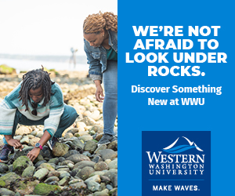
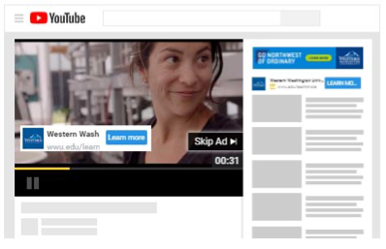
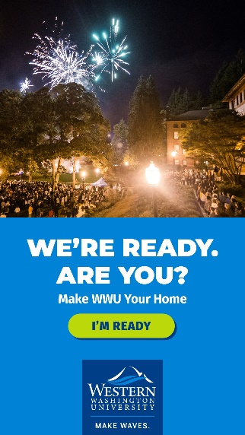
University Marketing & Brand Strategy (continued)
Click mouse to proceed through presentation
Recruitment & Brand Advertising
Recruitment campaigns are implemented both in-state and out-of-state across a range of strategies including:
Display Retargeting
Pay-per-click
Facebook & Instagram
YouTube
Snapchat
IP Targeting
Out-of-home advertising
Print
WESTERN WASHINGTON UNIVERSITY | MAKE WAVES.

Slide 10
Community Relations
Click mouse to proceed through presentation
The Office of Community Relations amplifies University connections by pairing the community’s needs with the resources and assets of Western.
Goals & Objectives:
Develop collaborative university-to-community partnerships, making Western more accessible, and benefiting both the university and the people of Washington.
Seek connections that lead to faculty research partnerships, student projects, community service and volunteer opportunities, and internship and job pathways.
Provide a conduit for supporting business development, data analysis needs, and collaboration.
Serve as the primary contact point for neighborhood residents concerning Western and its impact on the community.
WESTERN WASHINGTON UNIVERSITY | MAKE WAVES.

Slide 11
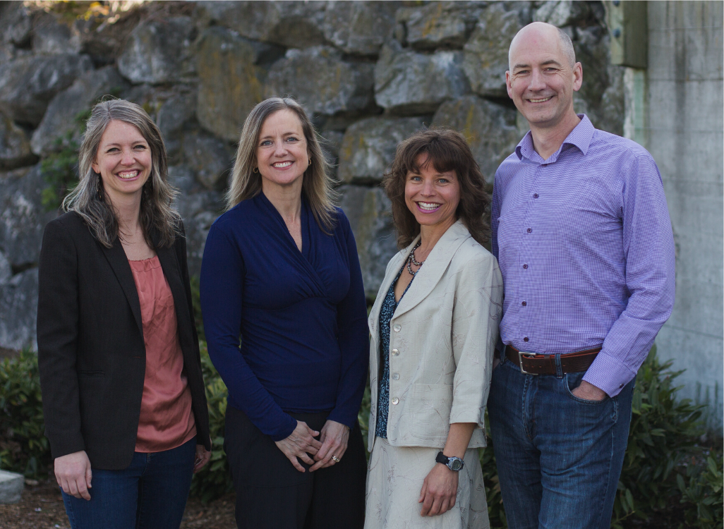
Small Business Development Center
Click mouse to proceed through presentation
The Small Business Development Center (SBDC) provides free tools, training and resources to help small businesses grow and succeed.
Since 1983, the SBDC has helped construct a statewide ecosystem to foster the spirit, support, and success of thousands of entrepreneurs and innovators.
The Small Business Development Center at Western Washington is funded in part by the U.S. Small Business Administration (SBA), the City of Bellingham, the Port of Bellingham, Whatcom County, and the City of Blaine.
In 2019, WWU added a second SBDC in Kitsap County funded in part by the City of Poulsbo, Kitsap Credit Union, Kitsap Bank, First Federal, and Kitsap Regional Library.
WESTERN WASHINGTON UNIVERSITY | MAKE WAVES.

Slide 12
Tribal Relations
Click mouse to proceed through presentation
In 2019, the WWU Board of Trustees approved a resolution recognizing the historic importance of establishing a Tribal Relations position to represent the WWU president and trustees as a liaison and envoy to American Indian/Alaska Native and First Nations governments. This position advocates for the support and success of American Indian/Alaska Native students at Western.
WESTERN WASHINGTON UNIVERSITY | MAKE WAVES.

Slide 13
Washington Coalition for the Public Good
Click mouse to proceed through presentation
WWU sponsors the state-wide Washington Coalition for the Public Good which serves as a coalition of higher education institutions committed to advancing the public purposes of colleges and universities, educating students for civic responsibility, and working in partnerships to cultivate vital and sustainable communities across the state.
WESTERN WASHINGTON UNIVERSITY | MAKE WAVES.

Slide 14
Web Communication Technologies
Click mouse to proceed through presentation
WebTech provides web development services, platforms and training for the Western community.
Goals & Objectives:
Develop and support the institutional website
Create and support platforms, sites, and tools for the university
Collaborate with faculty and departments to develop and support software for special academic needs
Provide design and digital usability expertise
Set web standards for usable, accessible, modern websites
Lead training and classes for web staff on campus
WESTERN WASHINGTON UNIVERSITY | MAKE WAVES.

Slide 15
Thank You
If you would like more information regarding University Relations & Marketing, please contact:
Donna Gibbs
Vice President for University Communications and Marketing:
(360) 650-3482
WESTERN WASHINGTON UNIVERSITY | MAKE WAVES.

