Slide 1
University Advancement

Slide 2
Division Overview
Vice President Kim O’Neill

Slide 3
UNIVERSITY ADVANCEMENT
The mission of University Advancement is to build relationships through meaningful engagements that foster pride, encourage advocacy, and promote private support for Western Washington University.

Slide 4
UNIVERSITY ADVANCEMENT SERVING WESTERN
Serving 136,935 Total Alumni
77.5% live in Washington
23% in King County
14% in Whatcom County
Serving Over 8,580 Donors Annually

Slide 6
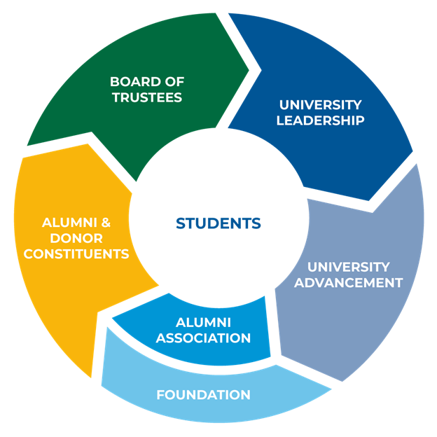

Slide 7
UNIVERSITY-WIDE FUNDING PRIORITIES
Western's current funding priorities include two sustainably designed capital projects—an advanced technology engineering and computer science building and a Coast Salish style longhouse.
The new STEM building responds to the needs of Washington state employers and student demand for increased access to electrical engineering, computer science, and energy degrees. The state is providing $53 million toward the $72 million project budget, with the balance of funds being raised through private contributions. The vision for a longhouse at Western originated from Western’s Native American Student Union and is the result of decades of discussion. The $5 million project has $4.5 million in state funds with the balance being raised through private contributions.
Other priorities include increasing scholarships aimed at recruiting and retaining students from historically underrepresented groups and strengthening graduate programs.

Slide 8
UNIVERSITY-WIDE FUNDING PRIORITIES
In addition to a $21 million fundraising goal for the FY23 year, President Randhawa has identified the following as additional fundraising opportunities that align with the strategic plan.
 | One Year Change | $ Needs | 2-3 Years Out
Recruitment | +300 students | Recruitment ($600k in year 1, increasing by $600k/yr through year 4) $450k/year – Fee waivers | ~3,500-3,600 to ~4,000-4,200 degrees awarded/yr 2,900 to 3,500 (frosh enrollment) 1,100 to 1,500 (transfer enrollment)
Retention | +1% | 20% expansion of current programs ($100k/yr) New program pilots ($200k) | 79% to 83%
Honors College | +25 students | Faculty ($125k/yr) Recruitment and retention ($600k/yr) | 235 to 300
Graduate Programs | --- | Marketing and recruitment ($200k) Increase # of teaching assistants ($200k/yr) | ~250 to ~350 degrees awarded/yr ~750 to ~850 enrollment

Slide 9
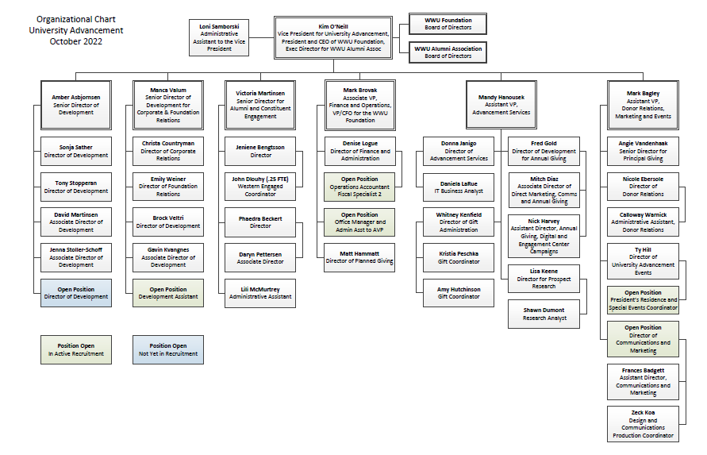

Slide 10
ADVANCEMENT SERVICES
Data Management: system implementation, maintenance, integrity, reporting
Manage advancement CRM (369,000+ records)
Manage digital platforms for event management, email, online giving, etc.
Coordination with central WWU IT
End-user training
Gift Administration
Gift processing (almost 18,000 pledges and gifts annually)
WWU Foundation gift acknowledgements and receipts
Constituent bio updates

Slide 11
PROSPECT RESEARCH AND MANAGEMENT
Partnering with frontline fundraisers to grow donor pipeline
Portfolio management
Gift officer metrics and goals
Prospect profiles showing giving capacity, wealth indicators, affinity, etc.

Slide 12
WWU PROSPECT DATA
Wealth-rated constituents including alumni, donors, friends Total = 265,977 records
Wealth-rated alumni (no donors or friends included) Total = 91,128 records (unknown excluded)

Slide 13
WWU ALUMNI PROSPECT DATA
Wealth-rated alumni (no donors or friends included) Total = 91,128 records (unknown excluded)

Slide 14
FY2023 KEY METRICS
 | FY2023 Goal | FY2022 | FY2021
Fundraising to Date | $21,000,000 | $17,437,556 62% increase | $10,773,725
% of Alumni Who Give | n/a | 3.04% | 3.58%
% of Donors Who Are Alumni | n/a | 46.28% | 55.90%
% of $ From Alumni | n/a | 39.94% | 26.81%
We are also working to add the median of our Engagement Score, which is currently under review.

Slide 15
MAJOR GIFTS AND ESTATE PLANNING
Centralized Model based on a capacity analysis
Development professionals strategically placed at each level of the pipeline:
$250,000 + Principal Gifts
$25,000 + Major Gifts
$1,000 + Mid-level gifts
Team of gift officers dedicated to securing gifts in support of fundraising priorities across the University
Prospect driven fundraising strategies
Regional outreach to areas with concentrations of high net worth, high affinity prospects
Professional Development focused on best practices to empower gift officers to more effectively penetrate the prospect pool and secure increased support for the institution
Estate Planning: Director of Planned Giving, and all gift officers trained and actively asking for estate gifts as a part of their major gift fundraising strategies

Slide 16
CORPORATE AND FOUNDATION RELATIONS (CFR)
CFR team is part of the centralized model for fundraising across all university units
Provide strategic management of corporate and foundation relationships toward successful solicitation of cash and in-kind gifts, with an emphasis on major ($25K+) and principal ($250K+) gifts
Oversees the development of mutually beneficial relationships that lead to strategic partnerships, including the development of comprehensive corporate partnership agreements and sponsorships packages
Oversees the discovery, cultivation, solicitation, and stewardship of gifts and philanthropic grants from foundations and corporations
Works closely with faculty and staff to identify funding opportunities and to develop successful grant proposals
Provides training to strengthen faculty and staff skills and ability to seek and secure philanthropic support

Slide 17
DONOR ENGAGEMENT CYCLE

Slide 18
DONOR RELATIONS, EVENTS AND COMMUNICATIONS
Sharing the personal impact philanthropy makes for students, faculty, and campus programs via one-on-one outreach, customized reports and special programming
Creation and production of engagement opportunities between donors, students, faculty and VIPs to encourage personal interactions and foster close ties to Western
Facilitate all communications with alumni, donors and friends of WWU through print, electronic, and social media channels
Production of annual Stewardship Report, e-newsletters, Window on Western articles, President's Report, invitations, proposals and marketing materials
Strategic management of President's, 1893, Old Main recognition societies, and named campus spaces
Facilitate open communication with campus partners to ensure timely and accurate information sharing
Friday, August 07, 2020
WESTERN WASHINGTON UNIVERSITY | MAKE WAVES.

Slide 19
ALUMNI AND CONSTITUENT ENGAGEMENT
Strategy development for engagement of all university advancement constituents including alumni, students, parents, donors, faculty/staff, and community/friends
Alumni and constituent events (live and virtual)
Alumni recognition activities and events
WE Connect alumni and student online networking and engagement platform
Academic and affinity-based events and programs for alumni through Western Engaged (WE)

Slide 20
ANNUAL GIVING
Annual giving strategy for all university advancement constituents (alumni, friends, parents, students, faculty/staff, etc.)
Securing gifts up to $24,999 annually through phone, text, electronic, direct mail channels
President's Society gifts of $1,000+
Manage online affinity campaigns, crowdfunding and peer-to-peer fundraising with VikingFunder
WWU Give Day: single day of giving to support the University
Engagement Center: soliciting gifts, thank you calls, etc.

Slide 21
FINANCE AND OPERATIONS
Treasury
Financial and accounting services
Endowment Investment management
Real estate transactions and management
Human resource functions
Budget, revenues and expenditures
Not-for-profit audit management
Contracts and Legal liaison

Slide 22
WWU ALUMNI ASSOCIATION
The mission of the WWU Alumni Association is to strengthen Western by building strong and caring relationships that make a difference among our students, alumni, friends, and the greater university community.

Slide 23
SIGNATURE PROGRAM
^{FACULTY/STAFF}
⁹¹
Our online community for professional connections, career growth opportunities, shared interests & mentoring opportunities.
Members have sent over 2,000 messages and made more than 600 connections.
Join today & start connecting:
weconnect.wwu.edu
²⁶⁹⁸
^{MEMBERS}
have joined since the system launched.
^{STUDENTS} ¹⁰⁴⁶
^{ALUMNI} ¹⁵³¹
^{FRIENDS}
³⁰

Slide 24
SIGNATURE PROGRAM
Western’s seventh annual Give Day, held on May 25, 2022, generated unprecedented levels of support for our students!
A record number of donors and dollars
2,905 DONORS gave a total of $1,073,309 (including matching funds)
We welcomed over 700 first-time donors,
a nearly 6% increase over last year.
Give Day grows our donor base and culture of philanthropy.
Save the date for 2023 Give Day – Thursday, May 25th!

Slide 25
WWU FOUNDATION
The mission of the WWU Foundation is to inspire philanthropy that advances access, learning, and innovation at Western Washington University.

Slide 26
WWU FOUNDATION
The Foundation was established in 1966 to receive and encourage private giving to WWU. Today, donors provide more than $15 million annually in the form of annual, endowed, and estate gifts, and gifts in kind such as real estate, equipment, and art. Gifts fund student scholarships and provide program and faculty member support.
The Foundation is led by a group of dedicated board members who raise awareness of the importance of private support to public institutions. These alumni, parents, and community leaders bring their experiences in business, education, science, and non-profits, and share the common mission of engaging new friends for Western and inviting financial investments, while also stewarding the more than $135 million in total assets under the Foundation’s management.

Slide 27
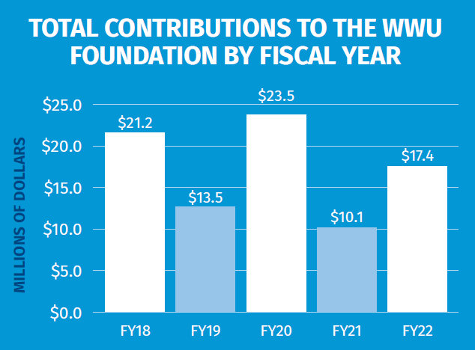
FUNDRAISING RESULTS
Fundraising results include all outright gifts, commitments and pledges made during the year. Note in 2020, recognition of the $10 million gift for Kaiser Borsari Hall.

Slide 28
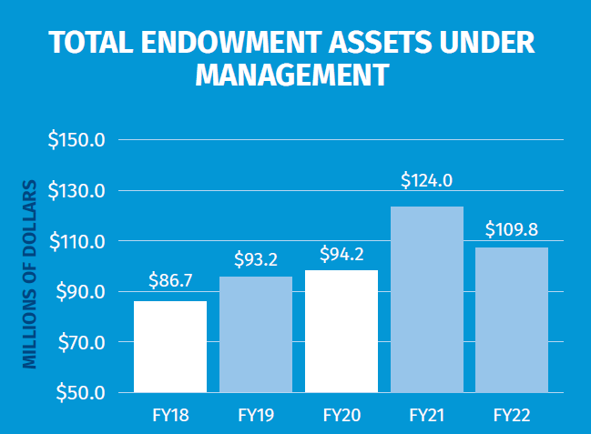
ENDOWMENT ASSETS UNDER MANAGEMENT
Total endowment assets under management include assets owned directly by the Foundation as well as endowed assets managed by the Foundation on behalf of the University. Note that total assets fell in FY22 due to significant volatility in the stock and bond markets.

Slide 29
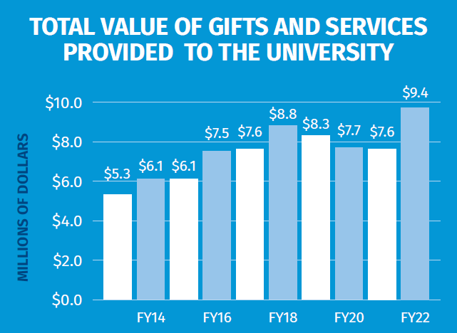
SUPPORT TO THE UNIVERSITY
Due to the COVID pandemic, and the resulting reduction in University activities, support requested from the Foundation dropped slightly from prior highs. However, support increased significantly in FY22 as students and classes returned to campus.

Slide 30
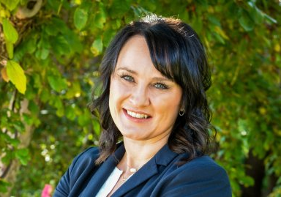
THANK YOU
If you would like more information regarding University Advancement, the WWU Foundation, or the WWU Alumni Association, please contact:
Kim O’Neill
Vice President for University Advancement President & CEO of the WWU Foundation
Executive Director of the WWU Alumni Association
(360) 650-2055
Kim.ONeill@wwu.edu

